Slide 1
YOUTUBE TRENDING
VS.
CORONAVIRUS
By Julianna Cole and Rhea Pavithran

Slide 2


Research Questions
What categories are popular on YouTube?
Does YouTube’s trending page really contain the most popular videos?
Is there a relationship between the popularity of videos on YouTube about the coronavirus and the number of coronavirus cases in the United States?

Slide 3
Why did we choose this topic?
Our interest in YouTube as a source of news, entertainment, & more
Controversy surrounding the accuracy of the YouTube Trending page
To discover the most popular categories on YouTube
To benefit content creators by showing them categories that are successful
To gain insight into what is popular in our culture today
To determine if the increase in coronavirus related videos was due to an increase in US cases or media sensation

Slide 4

How did we gather our data?
Every day for two weeks between March 6 - March 22 at 8:00 PM, we recorded information about the top 15 videos on YouTube Trending
Title
Ranking on trending page
Category
Views

Slide 5
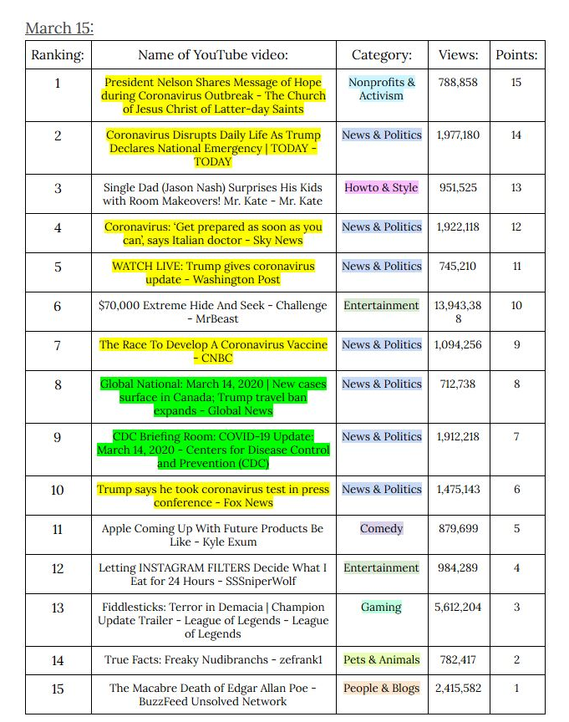
Sample Daily Recording
In addition to the information about each video, we also created a scoring system
#1 on Youtube Trending: 15 points
#2 on Youtube Trending: 14 points
…
#15 on Youtube Trending: 1 points
This scoring system allowed us to weigh each videos’ popularity
Color-coding:
Yellow highlighted titles: contain the word “coronavirus”
Green highlighted titles: contain words related to coronavirus (“COVID-19”, “quarantine”, etc.)
Each category highlighted with different color

Slide 6
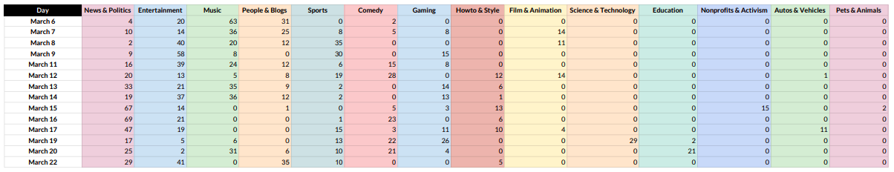
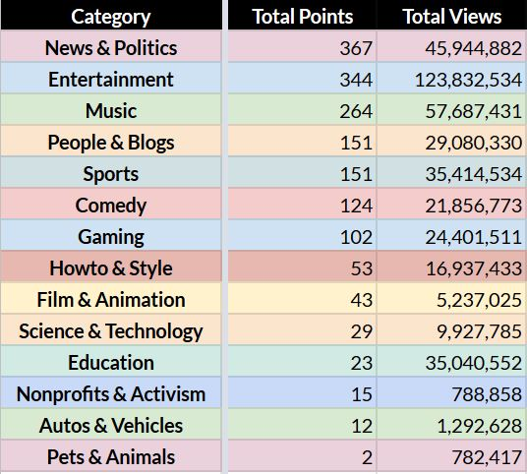
YouTube Category Ranking Over Time
We created a spreadsheet totaling the number of points in a category on any given day
We then created a second table to record the final values of these categories in order from highest to lowest, as well as the total number of views for each category
In terms of points, News & Politics was the highest, and Pets & Animals was the lowest

Slide 7
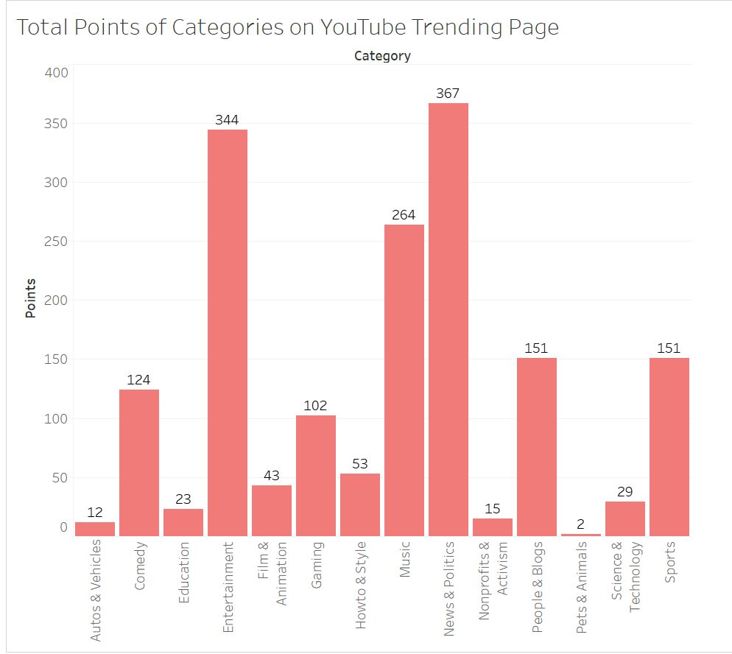
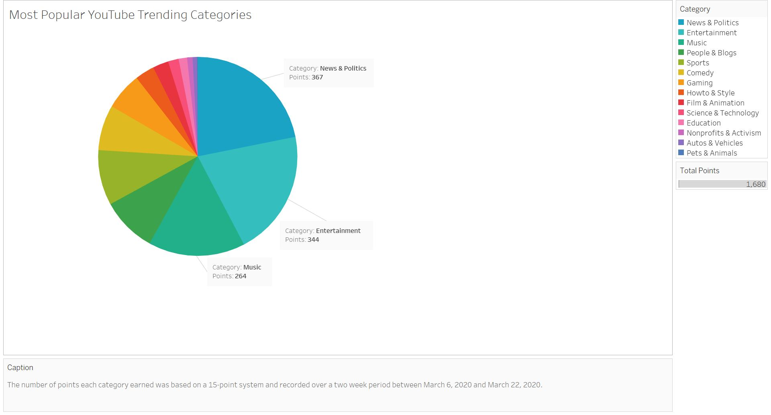
YouTube Trending Categories and Their Rankings
We converted our rankings of the categories and compared them to each other using both a bar graph and pie chart in order to visualize the data
Because of the recent spike in coronavirus updates, News & Politics takes up the largest portion of the graph

Slide 8
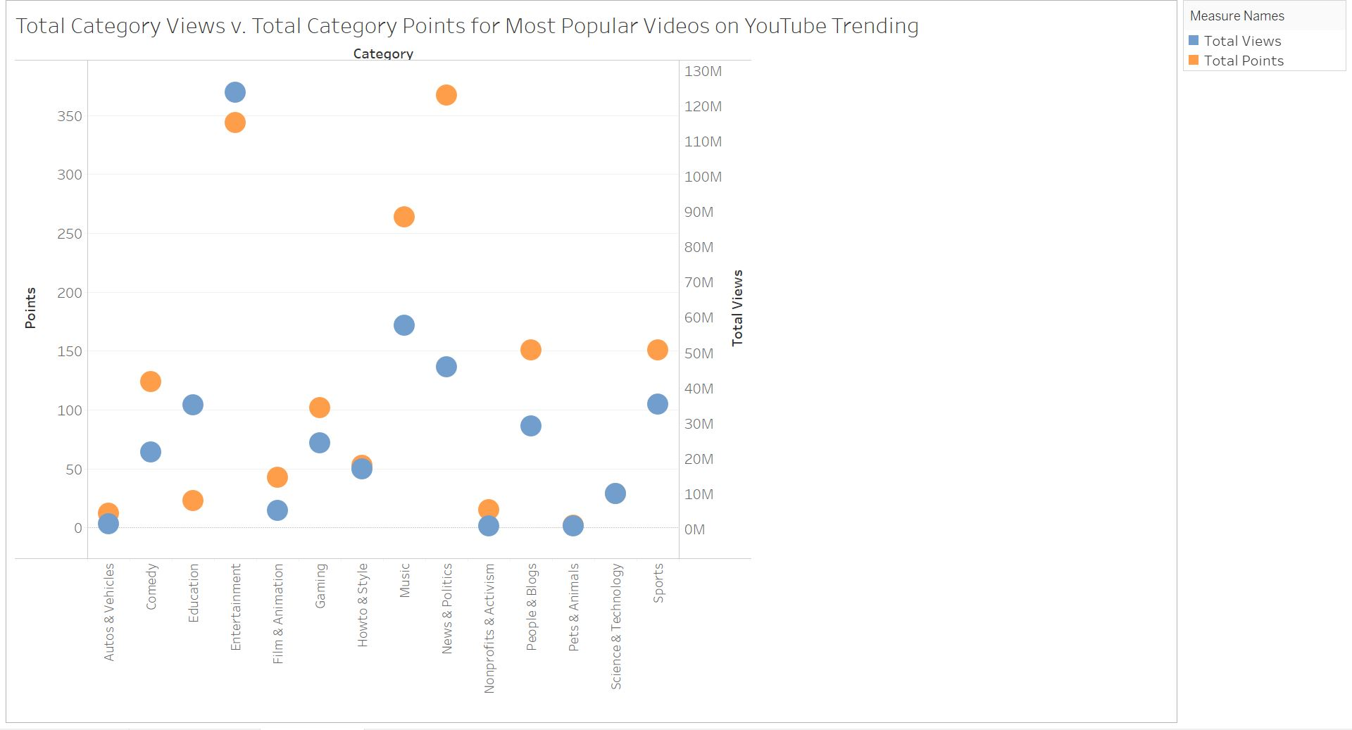
Total Category Views v. Total Category Points
We then created a scatter plot comparing the total number of views a category received with the total number of points received
Although News & Politics had the highest ranking, it did not have the highest number of views
Entertainment was ranked #2, but has the highest views

Slide 9
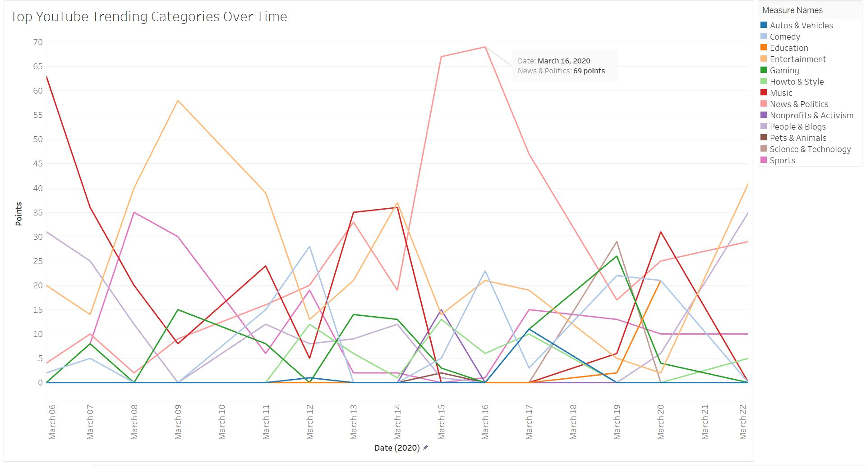
YouTube Trending Categories over Time
We created a line graph that demonstrates how the popularity of these categories fluctuates over time
This helped us visualize the drastic increase of videos under News & Politics

Slide 10
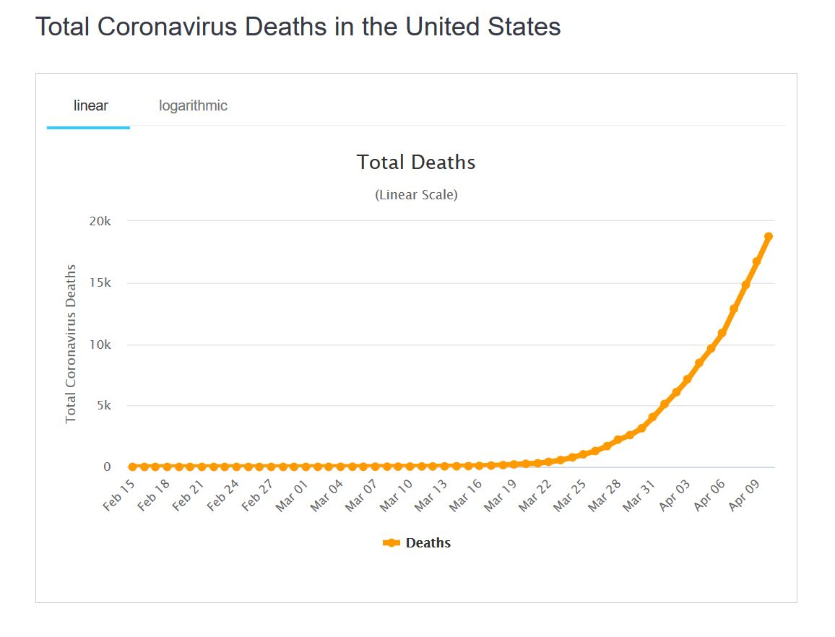
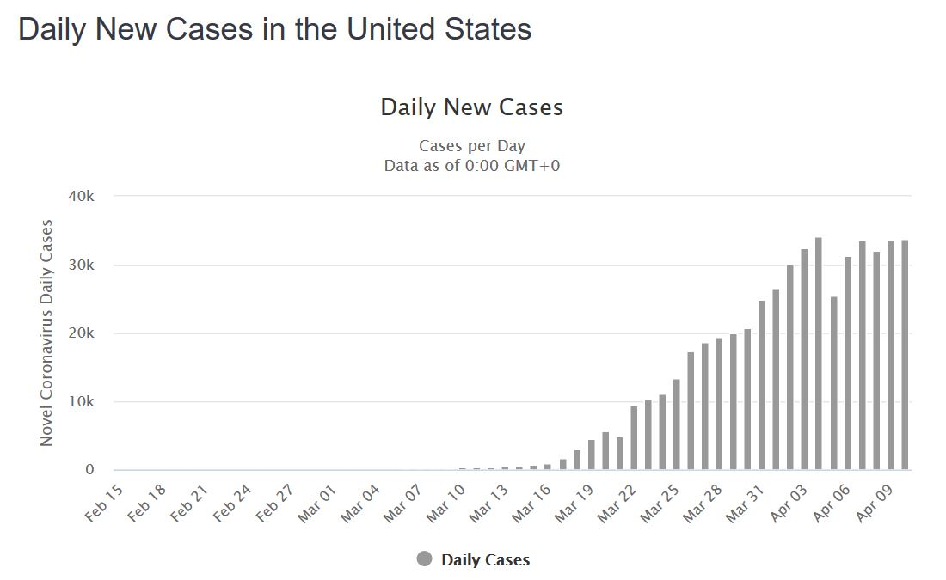
US Coronavirus Statistics
Worldometer helped us create a dataset for US coronavirus statistics
Using total deaths and daily new cases allowed us to see how severe the recorded cases are and how quickly it is spreading across the United States
Daily new cases increase after March 10, whereas total deaths increase after March 20

Slide 11
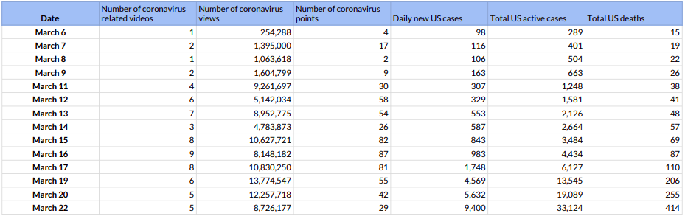
Coronavirus on YouTube Trending vs. US Coronavirus Statistics
We calculated the number of coronavirus related videos, as well as the number of views and points earned
We compared this to the coronavirus datasets we recorded (daily new cases, total active cases, total deaths in the US)
This helped us compare the peak days of the virus vs. the peak days the virus appeared on YouTube

Slide 12
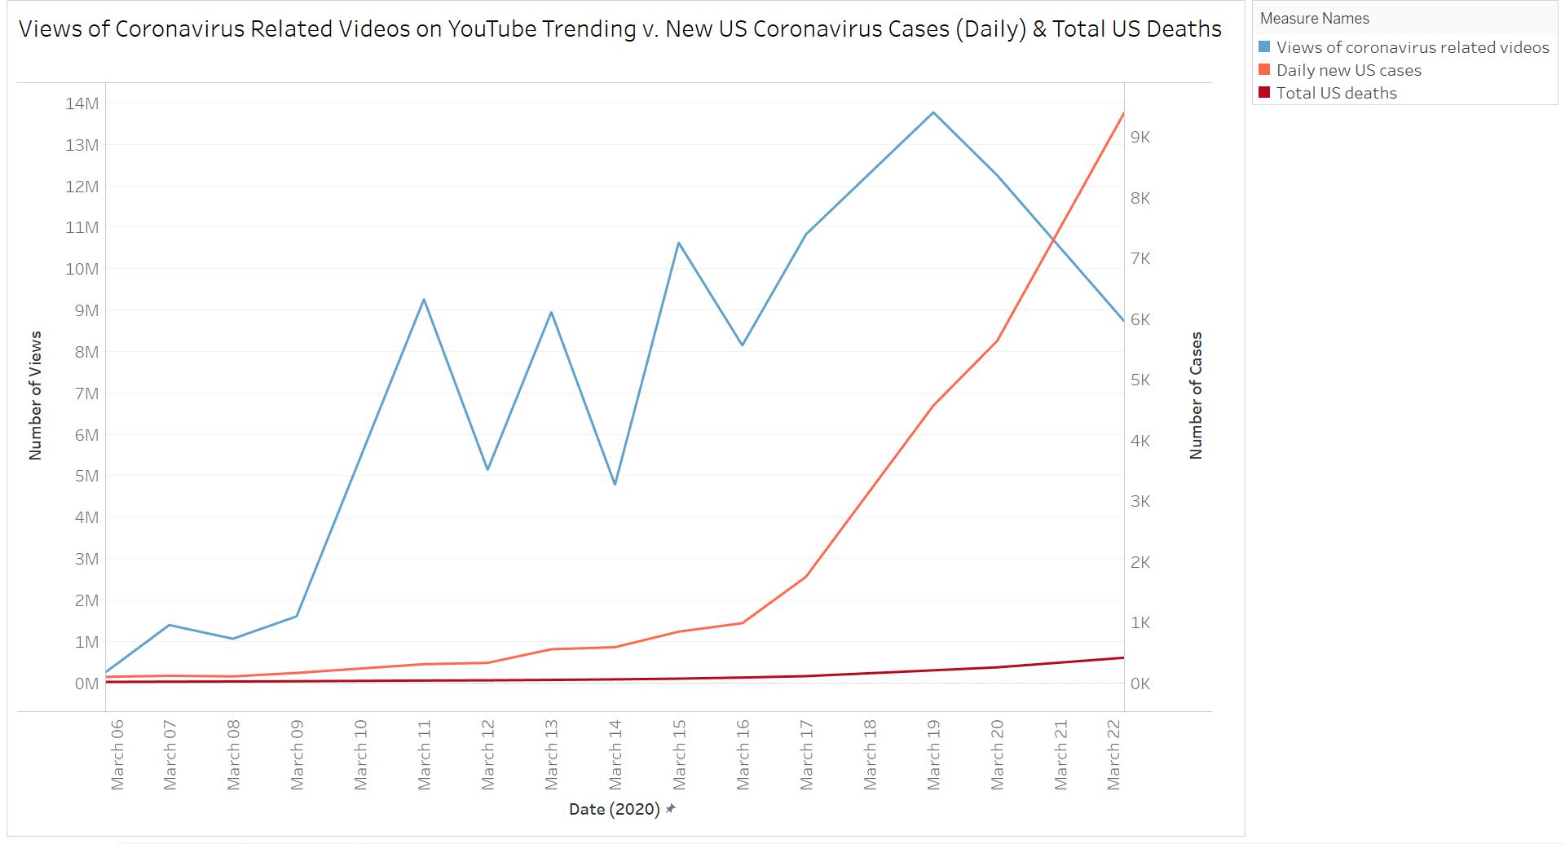
Coronavirus Related Video Views vs. US Coronavirus Statistics
We compared our research on coronavirus related videos with the increase of coronavirus cases in the US in three ways
The first way was by comparing the total number of views these videos received with daily new cases and total deaths in the US
The views of coronavirus related videos fluctuates, but increases overall

Slide 13
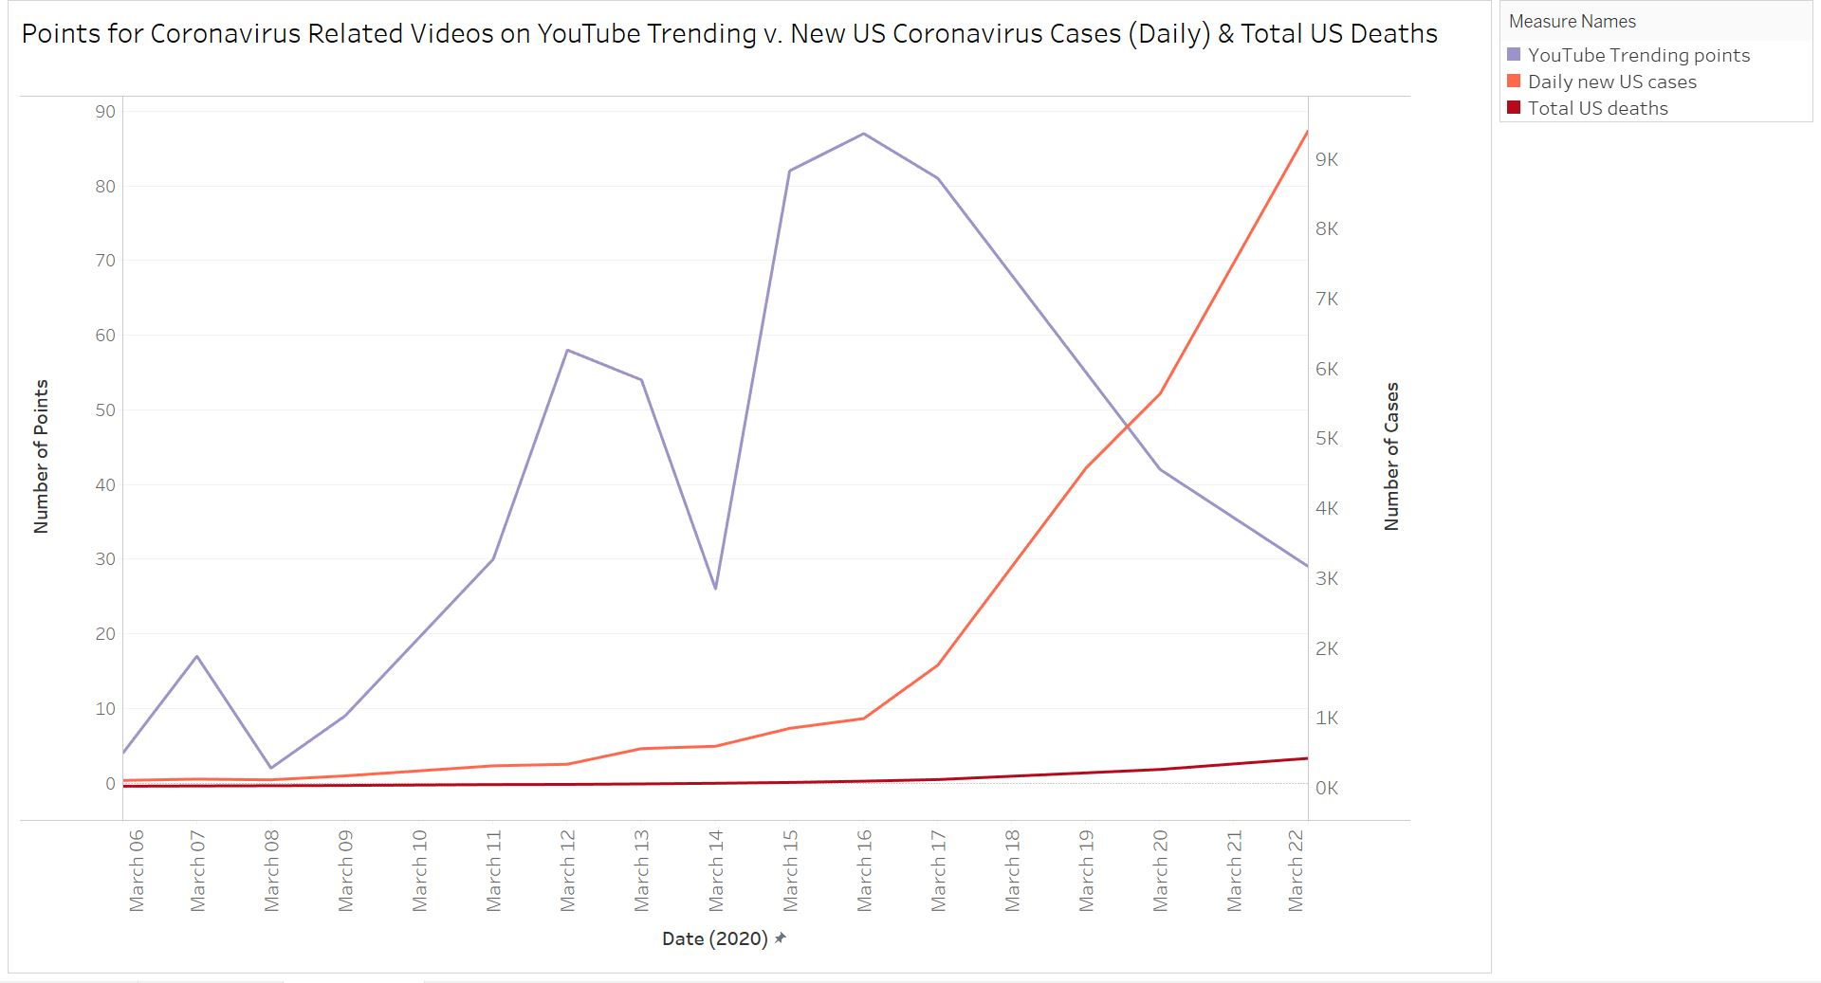
News & Politics Category Points vs. US Coronavirus Statistics
The second way was by comparing the points under the News & Politics category with daily new cases and total deaths in the US
The popularity of this category increased over 14 days, but peaked at March 16, although total cases and total deaths were still increasing in the US

Slide 14
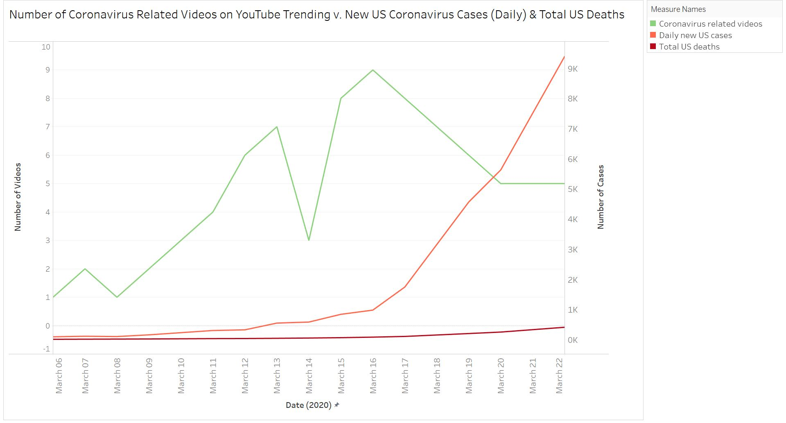
Number of Coronavirus Related Videos vs. US Coronavirus Statistics
The second way was by comparing the number of coronavirus related videos with daily new cases and total deaths in the US
The number of coronavirus related videos peaked at March 16, although the number of new cases and total deaths were both increasing

Slide 15
Results
What categories are popular on YouTube?
Total points:
News & Politics - 367
Entertainment - 344
Music - 264
Total views:
Entertainment - 123,832,534
Music - 57,687,431
News & Politics - 45,944,882

Slide 16
Results
Does the YouTube Trending page really contain the most popular videos?
Our data leads us to believe the answer is YES
Category total views and points are in alignment with the exception of News & Politics
News & Politics videos are likely gaining views at a much faster pace than other categories, especially due to COVID-19, ranking them higher on the page

Slide 17
Results
Is there a relationship between the popularity of videos on YouTube about the coronavirus and the number of coronavirus cases in the United States?
YES
Views, points, and total number of coronavirus related videos increased as the number of cases in the US increased
Notably, from March 14 - March 15
Points: from 26 to 82
Deaths: from 57 - 69
Active cases: from 587 - 843

Slide 18
Resources
“United States Coronavirus Cases” (2020). Retrieved from
https://www.worldometers.info/coronavirus/country/us/
“YouTube Trending” (2020). Retrieved from https://www.youtube.com/feed/trending

